Slide 1
Monday, 4/11/22
Any Questions?
Exam 2
Project 5
Java Interfaces | Don’t modify them
Project 4
Module Topic
Graphs | Week 2
Activities 10.1 & 10.2

Slide 2

Project 4 | Are You Done?
Notes:
What’s wrong

Slide 3
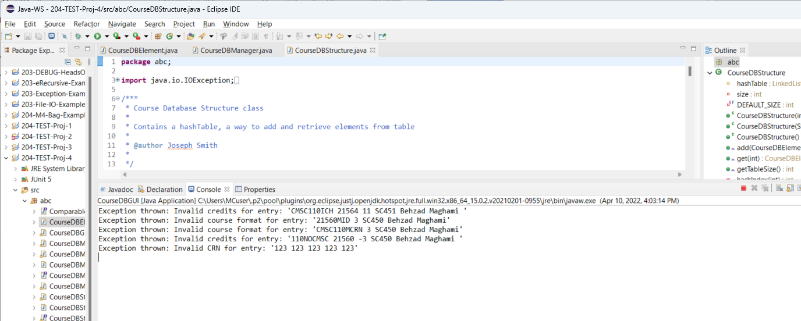
Project 4 | Expectations

Slide 4
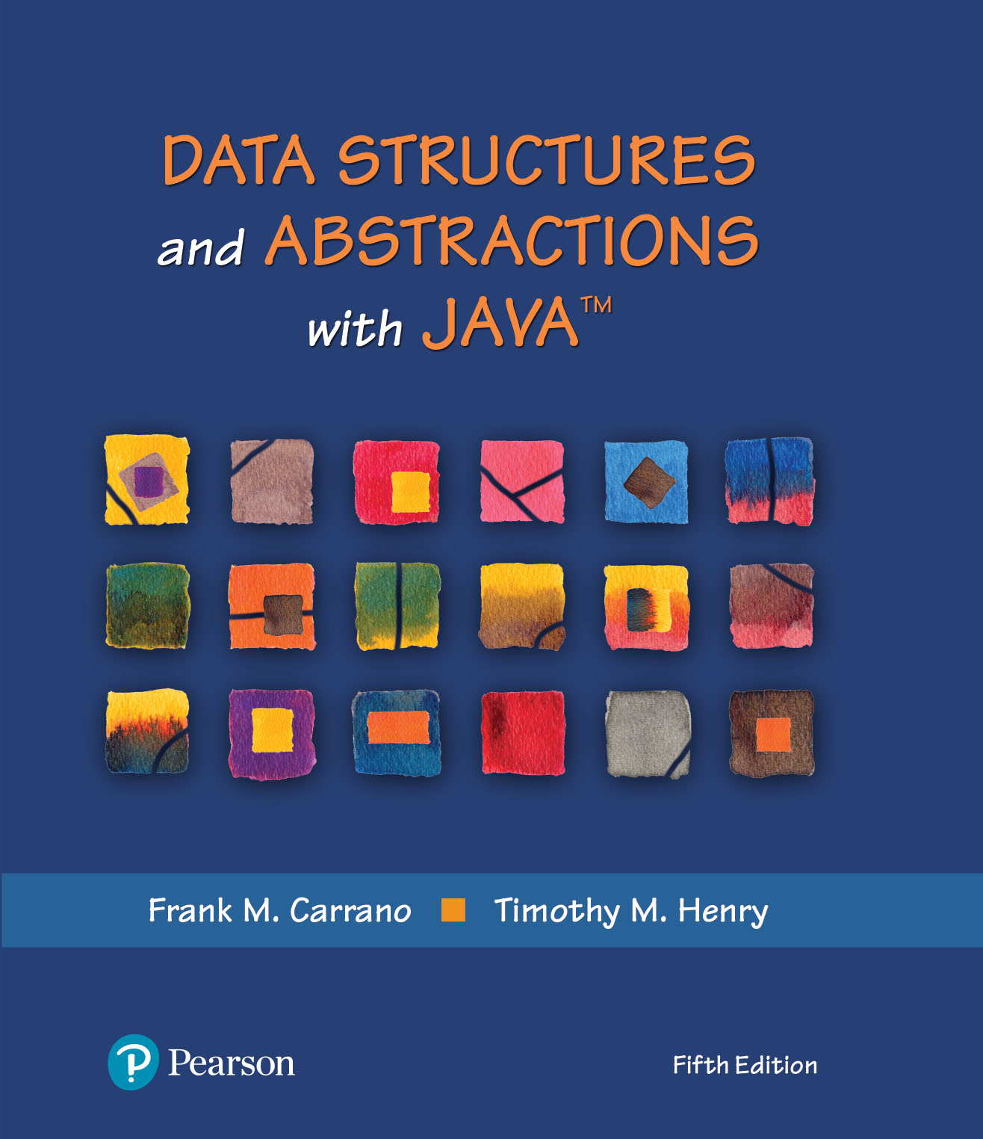
Module 20 - Graphs
Ch. 29 – Graphs
Ch. 30 – Graph Implementation

Slide 5
Adjacency Matrix vs. Adjacency List
Graph vs. Tree implementations
Vertices & edges
Common implementations
Array | adjacency matrix
Typically a two-dimensional array
List | adjacency list
Linked nodes
Why “adjacency” list (or matrix)?
Don’t know where to go “next”
Unlike tree, linked list, array

Slide 6
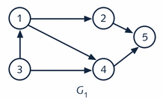
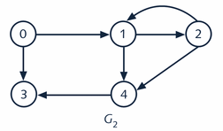
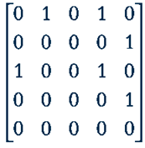
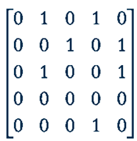
Adjacency Matrix (2D-Array Representation)
edge
edge
vertex[0]
1
vertex[0]
0
vertex[1]
2
vertex[1]
1
vertex[2]
3
vertex[2]
2
vertex[3]
4
vertex[3]
3
vertex[4]
5
vertex[4]
4
Notes:
1, 2, 3, 4 & 5 are “names” of vertices
Array (of vertices) + 2-D array (“edge”)
What’s the point with “adjacency” matrix or list

Slide 7
“Real World” Example
Vertex array is an array of node references
Edge array is a two dimensional array
Called the adjacency matrix
0 in edge[i][j] indicates no edge from vertex i to vertex j
Symmetric for undirected graphs
0 1 2 3 4
0 0 1 0 1 1
1 1 0 1 1 0
2 0 1 0 0 0
3 1 1 0 0 1
4 1 0 0 1 0
26
edge
82
Philidelphia
vertex[0]
26
600
vertex[1]
600
New York
vertex[2]
1000
1000
vertex[3]
44
Boston
2
vertex[4]
300
44
1
Los Angeles
300
0
Houston
3
4
Notes:
What are the 26,600, 1000, 44 and 300?
What is the adjacency matrix for?

Slide 8
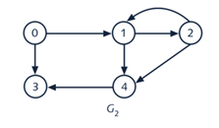
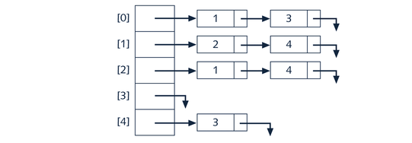
Adjacency List | “Next”
vertex[0]
0
vertex[1]
1
vertex[2]
2
vertex[3]
3
vertex[4]
4
Notes:
From 0, I can go to 1 or 3 next
Similar to … Hashing …

Slide 9
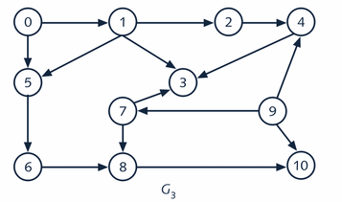
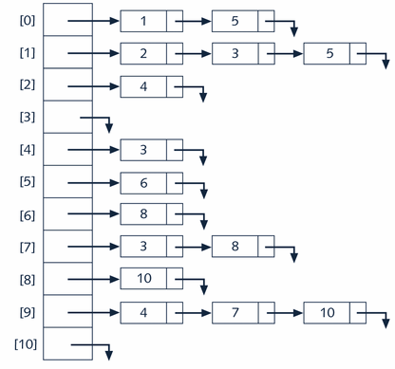
Adjacency List for G3
vertex[0]
0
vertex[1]
1
vertex[2]
2
vertex[3]
3
vertex[4]
4
. . .
vertex[10]
10

Slide 10
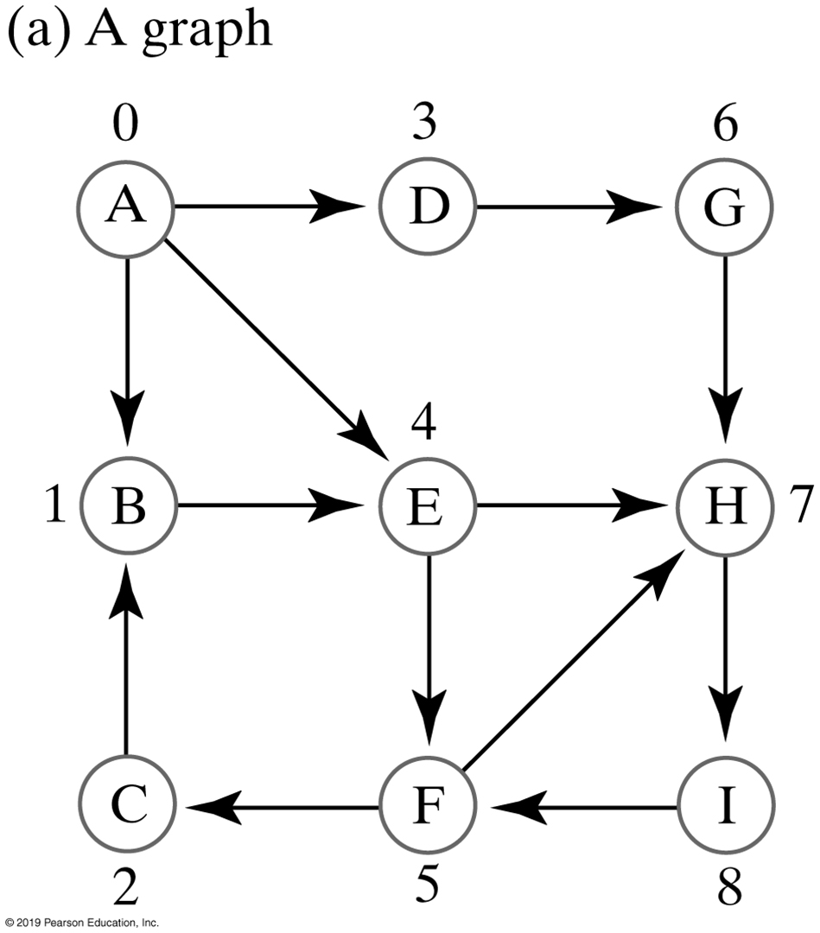
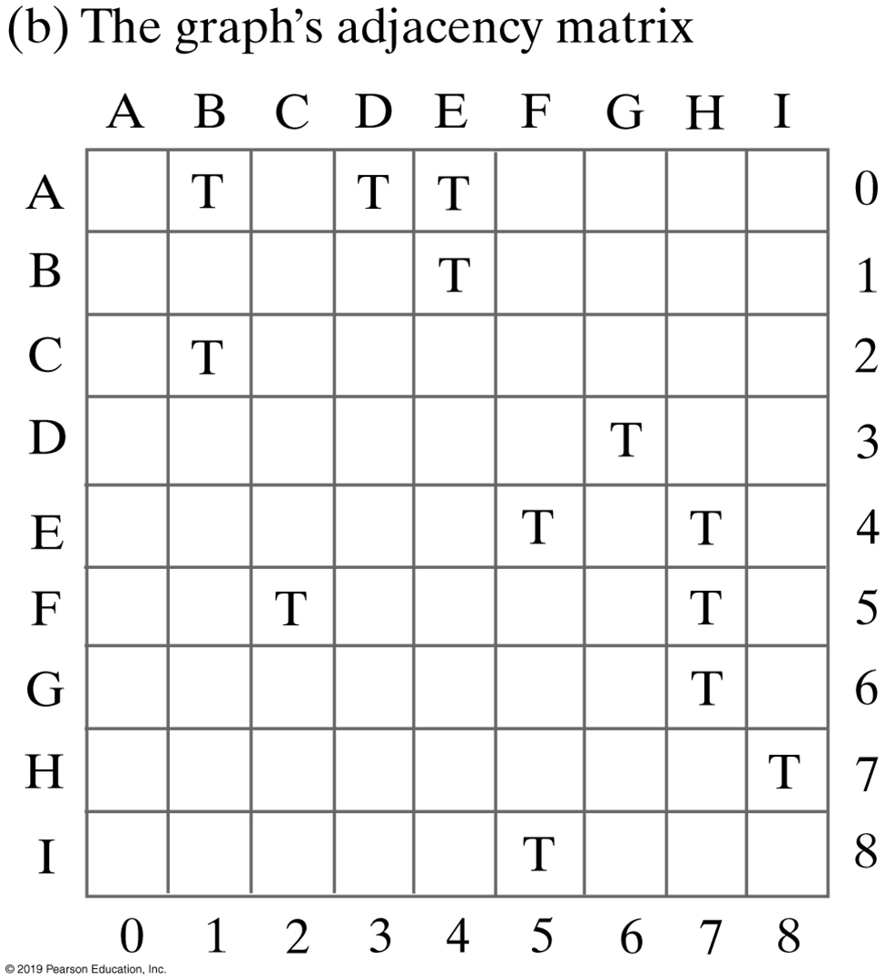
Another Example
Notes:
Unweighted, Directed Graph & Adjacency Matrix

Slide 11
Learning Activity
Derive the adjacency matrix for the following graph
2
1
0
3
4

Slide 12
Activity | Solution
0 1 2 3 4
0 0 1 0 1 1
1 1 0 1 1 0
2 0 1 0 0 0
3 1 1 0 0 1
4 1 0 0 1 0
26
edge
82
Philidelphia
vertex[0]
26
600
vertex[1]
600
New York
vertex[2]
1000
1000
vertex[3]
44
Boston
2
vertex[4]
300
44
1
Los Angeles
300
0
Houston
3
4
Notes:
Same adjacency matrix, regardless where you start

Slide 13
World Tour
A
B
3
16
9
4
F
5
C
8
E
6
1
2
H
G
7
I like to visit every city, what’s the best way to do so?
Determine a set of “paths” that connects all cities
Notes:
Is there a connectivity between these cities

Slide 14
Connectivity (Spanning Tree)
A
B
3
16
9
4
5
F
C
8
E
6
1
2
G
H
7
Connectivity vs. shortest path | Going from A to E
Notes:
The spanning tree of a graph (G) is a subset of G that covers all of its vertices using the minimum number of edges
https://www.educative.io/edpresso/what-is-a-spanning-tree

